Slide 1
The Early 17th Century
1603-1660
Week 3 part 1

Slide 2
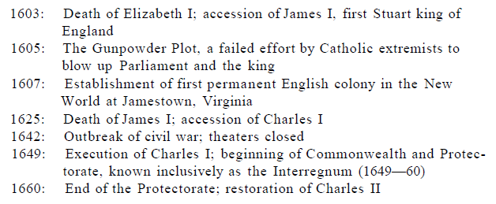

Slide 3
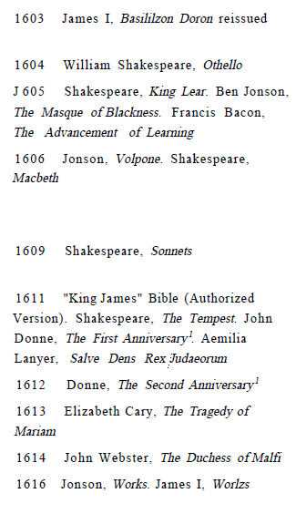
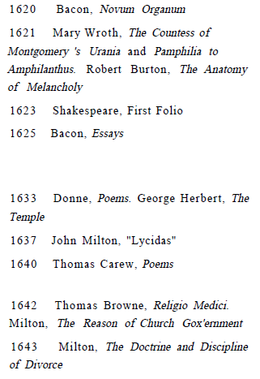
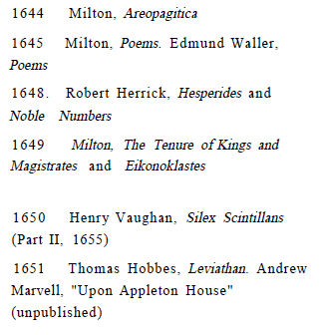
Major Works of Literature

Slide 4
Social, historical, political summary
Queen Elizabeth died without an heir.
James VI of Scotland became king as James I
He wrote treaties and literary works
His views were sharp in monarchic power: unconditional obedience
This brought problems with House of Lords and Commons
His son Charles I continued problems a civil war broke out in 1642 and he was beheaded in 1649.
Oliver Cromwell came to power as Lord Protector until his death in 1658.
In 1660 a new monarch came to power as Charles II
The protestant revolution still continued and created turmoil inside the country.

Slide 5
Literature between 1603-1640
John Donne, Ben Jonson
Ptolemaic universe,
Melancholic works were common
The great Chain of Being, order of universe
Francis Bacon, empiric method, experiment as source of truth
The Advancement of Learning, Novum Organum, The New Atlantis
Copernicus, Galileo
Patronage, printing, acting companies
Shakespeare, the theater
Tragedies, The Duchess of Malfi, Volpone

Slide 6
Jacobean Writers
Ben Jonson
John Donne, George Herbert
Sonnets, pastoral poems
Cavalier poets, Rober Herrick, Thomas Carew, Ricard Lovelace, John Suckling, Edmund Waller, Henry Vaughan
Metaphysical poets, John Donne, Gorge Herbert, Richard Crashaw, John Cleveland, John Suckling, Abraham Cowley, Anrew Marvell
Francis Bacon, Thomas Hobbes
Women writers; Aemilia Lanyer, Elizabeth Cary, Rachel Speght, Lady Mary Wroth

Slide 7
Caroline Era 1625-1640: Milton Lycidas, Donne Poems
The Ravolutionary Era 1640-1660:
1642, theatres closed
Cavalier poets
Thomas Hobbes, Leviathan
Milton, Areopagitica, Poems

